Slide 1

Welcome! The meeting will start in a few minutes.
Practitioners’ Network: Thematic Working Group – Private Sector Workstream „from strategy to implementation“ 22 March 2022, 13:30 - 16:30

Slide 2





About the netiquette of this meeting
State your name and MSO before you ask a question
Turn off your camera and microphone unless you are presenting or asking a question
Raise your virtual hand to ask a question or write it in the chat

Slide 3
Agenda
13:30 – 13:40 - Background and Introduction
13:40 – 14:20 Strategic framework for Women Economic Empowerment Interventions from DG INTPA, DG NEAR and AECID
14:20 – 15:00 Donor Committee on Enterprise Development
Intervention from DCED and FemDev Consulting
15:00 – 15:15 Break
16:20 – 16:30 Wrap up and closure
15:15 – 16:20 Exchange experiences MSOs
Intervention from Expertise France, EU Delegation Zimbabwe and ICR Facility (BC)

Slide 4
PN HOUSEKEEPING
Dear MSO‘s we kindly ask you to register on the PN website and thereby indicate your participation in this Private Sector Workstream. Thank you very much!
You will find further information on how to register on the link below:
https://www.dev-practitioners.eu/static/tutorials/howto_register.m4v

Slide 5
Agenda
13:30 – 13:40 - Background and Introduction
13:40 – 14:20 Strategic framework for Women Economic Empowerment Interventions from DG INTPA, DG NEAR and AECID
14:20 – 15:00 Donor Committee on Enterprise Development
Intervention from DCED and FemDev Consulting
15:00 – 15:15 Break
16:20 – 16:30 Wrap up and closure
15:15 – 16:20 Exchange experiences MSOs
Intervention from Expertise France, EU Delegation Zimbabwe and ICR Facility (BC)

Slide 6
Women’s Economic Empowerment DG INTPA and DG NEAR
Gender and private sector development
Joanna Kahiluoto, INTPA E2
Ilektra Tsakalidou, NEAR B2
Eloise Roos-Kilhoffer, NEAR B2

Slide 7
Women’s economic empowerment in DG INTPA and DG NEAR
Framework for WEE and how this translates into action
INTPA work on WEE
NEAR and WEE

Slide 8

EU Legal and Policy Framework for WEE
Treaties – EU value and objective – and Regulations
e.g. NDICI and EFSD+
EU Global Strategy, European Consensus on Development
EU Gender Equality Strategy 2020
Gender Action Plan III for EU external action (2021-2025)
Also the EU MS committed*

Slide 9


Mainstreaming
Country level implementation and engagement with stakeholders
Leading by example
Reporting – accountability
Key areas of engagement – thematic priority areas

Slide 10






GAP III: Six key areas of engagement

Slide 11
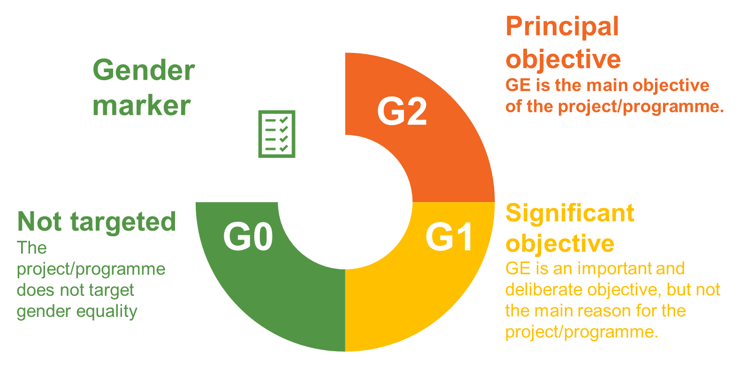
GAP III translated into actions
Gender country profile
Sector-specific gender analysis
Gender analysis in action document

Slide 12






GAP III - Key areas for WEE
Social Protection
Access to financial services, land and property rights
Entrepreneurship and Private Sector Development
Women’s representation in leadership
Productive employment and decent work
Care services and Unpaid care work
Education and skills development
Increased access for women, to decent work, including women’s transition to the formal economy
Improved policy, legal framework and access to care services
Increased access for women to financial services and products, productive resources and entrepreneurship opportunities
Improved access for women in all their diversity to managerial and leadership roles
Reduction in gender disparities in enrolment, progression and retention at all levels of education

Slide 13

WEE – Strands of Action
Enabling environment for women to participate in the economy – structural changes for an economy that works for all, e.g. ICR
Innovative finance in support of WEE, e.g. EFSD+ and IYBA
Targeted support actions across sectors, e.g. on sectors with high numbers of women and with high potential for opportunities, e.g. Tony Elumelu Foundation, Digital2Equal
4. WEE in INTPA

Slide 14
Women Economic Empowerment in the Southern Neighbourhood
New Agenda for the Mediterranean
NDICI Regulation
GAP III
Regional MIP 2022
Annual Programming

Slide 15
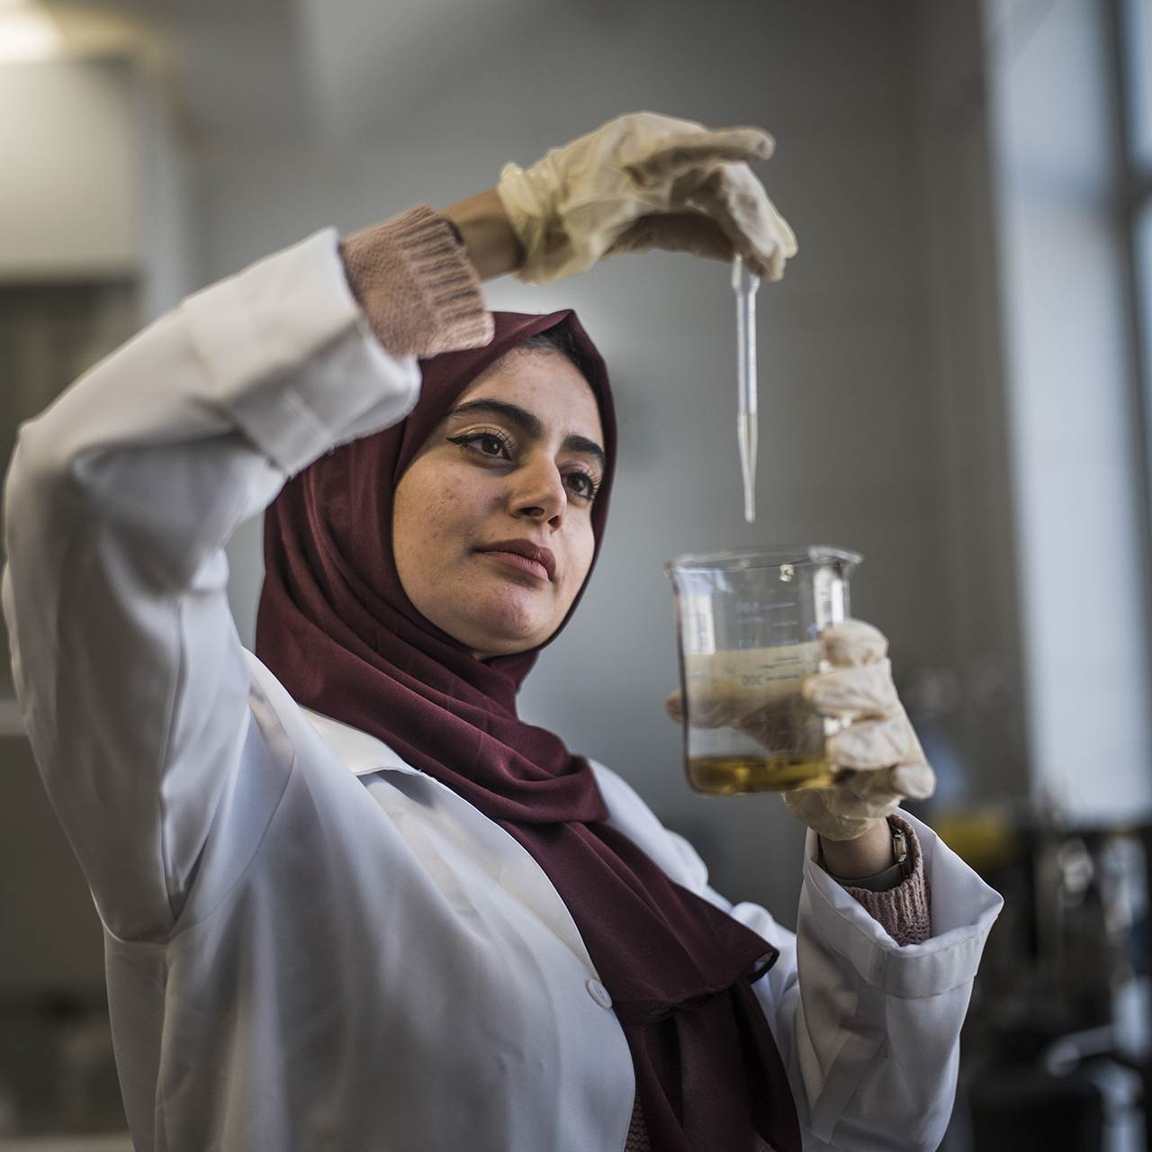
Women as agents of change in the region
Women increasingly well-educated and skilled, yet labour market participation remains low.
Stronger participation in employment, entrepreneurship and public life could substantially accelerate economic growth, financial inclusion, job creation, and the post-COVID-19 recovery.
Household earnings could rise by up to 25%, increasing their families’ and communities’ wellbeing.
Lower rates of financial inclusion & bottlenecks to access finance.
Dynamism from women, especially young women, to become active part of change.

Slide 16
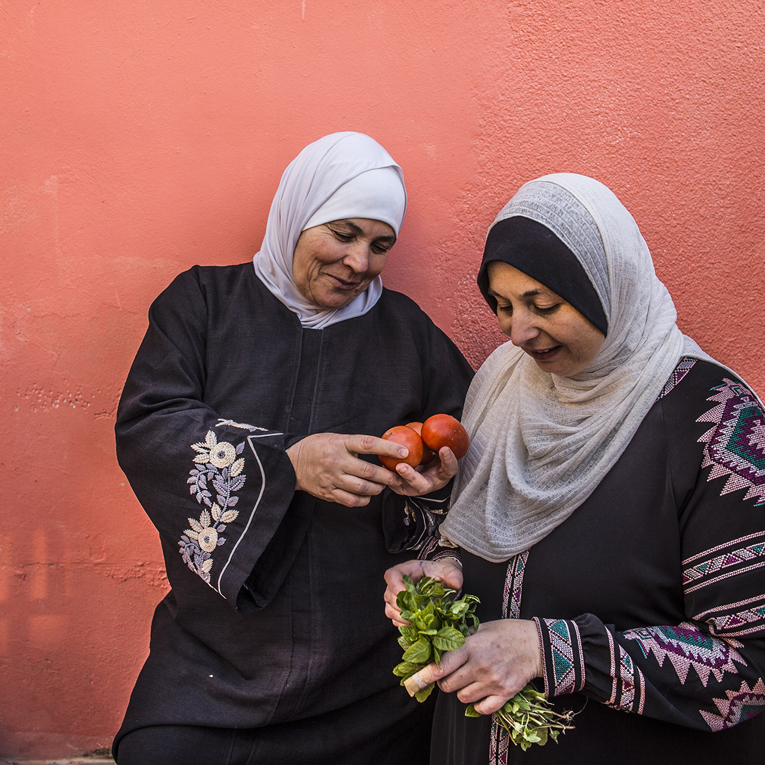
Regional Programme in the making
Focused approach on financial inclusion and access-to-finance.
Complementarity with EUD bilateral actions.
Could be accompanied by financial instrument.
Two-pronged approach:
Support to the regulatory environment/ regional exchange
Skills and tools for women
Next steps:
Development of Action Document
Internal Quality Check
NDICI Committee

Slide 17

Thank you
© European Union 2020
Unless otherwise noted the reuse of this presentation is authorised under the CC BY 4.0 license. For any use or reproduction of elements that are not owned by the EU, permission may need to be sought directly from the respective right holders.
Slide xx: element concerned, source: e.g. Fotolia.com; Slide xx: element concerned, source: e.g. iStock.com

Slide 18
Agenda
13:30 – 13:40 - Background and Introduction
13:40 – 14:20 Strategic framework for Women Economic Empowerment Interventions from DG INTPA, DG NEAR and AECID
14:20 – 15:00 Donor Committee on Enterprise Development
Intervention from DCED and FemDev Consulting
15:00 – 15:15 Break
16:20 – 16:30 Wrap up and closure
15:15 – 16:20 Exchange experiences MSOs
Intervention from Expertise France, EU Delegation Zimbabwe and ICR Facility (BC)

Slide 19

The Donor Committee for Enterprise Development: Women’s Economic Empowerment Working Group
Jim Tanburn, Coordinator
Lisanne van Beek (RVO/CBI), Co-chair
Claudia-Dominique Geiser (BMZ/GIZ), Co-chair
Practitioners’ Network, 22 March 2022
Notes:
V. 15 March 2022

Slide 20
Brief Introduction to the Donor Committee for
Enterprise Development (DCED)
Jim Tanburn, Coordinator
Notes:
V. 15 March 2022

Slide 21

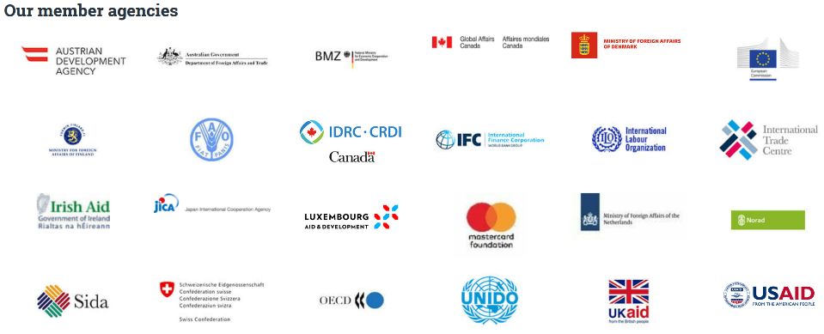
THE DCED IS A FORUM OF 24 MEMBER AGENCIES…
”
the independent and respected point of reference for standards, knowledge and data on the role of the private sector in development
Slide 21

Slide 22
…FOCUSING ON PRIVATE SECTOR DEVELOPMENT…
Private Sector Development (PSD) is defined for this purpose as:
the range of strategies that aim to establish markets that function vibrantly and fairly, providing economic opportunities of quality to poor people at scale.
”
Slide 22

Slide 23
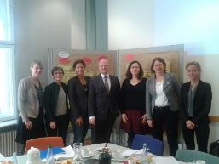
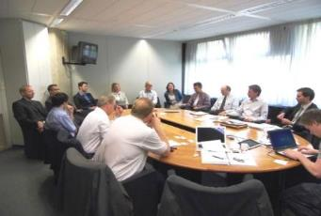

STRUCTURE OF THE DCED:
WORKING GROUPS
WGs formed in response to member interest to
share practical experiences
document lessons learned, effective practice
Market Systems Development
Private Sector Engagement
Women’s Economic Empowerment
Business Environment Reform
Green Growth
Results Measurement
Slide 23

Slide 24
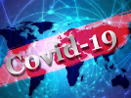
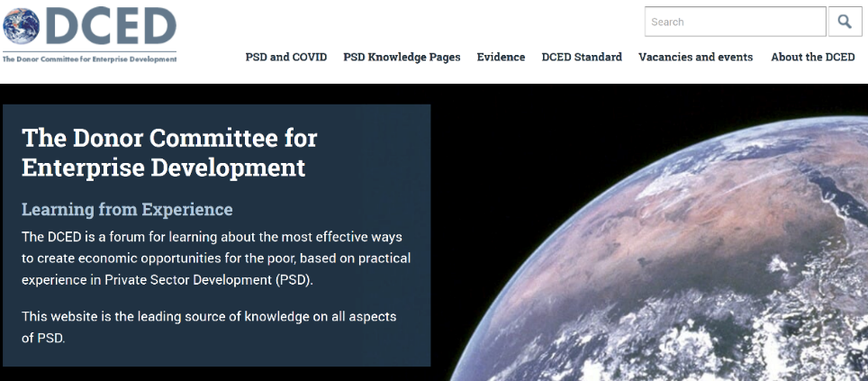
THE DCED WEBSITE…
The DCED website attracts 175,000 page views per year
Results Measurement / DCED Standard
PSD responses to COVID-19
Industrial Policy
Many other themes
Slide 24

Slide 25
Women’s Economic Empowerment (WEE)
Working Group
Lisanne van Beek (RVO/CBI), Co-chair
Claudia-Dominique Geiser (BMZ/GIZ), Co-chair
Notes:
V. 15 March 2022

Slide 26
OVERVIEW OF THE WEE WG
Oversee a portfolio of work items on topics that are decided on by the Working Group annually. Each work item is overseen by a smaller ‘task team’. Currently, these are:
WEE Gateway
Gender lens investing
MSMEs and the Care Economy
The Role of Social Norms for WEE
COVID-19 and WEE
Meet 2-3 times per year in Working Group meetings to share individual agency updates on WEE, and updates on work items
Steered by 2 Co-chairs, with support from the DCED Secretariat
Slide 26

Slide 27

OVERVIEW OF THE WEE WG
The Working Group organises webinars, e.g., most recently on Promoting Women’s Economic Empowerment During COVID-19
We also have a podcast: WEE Talks: Small chats, big topics
Slide 27

Slide 28
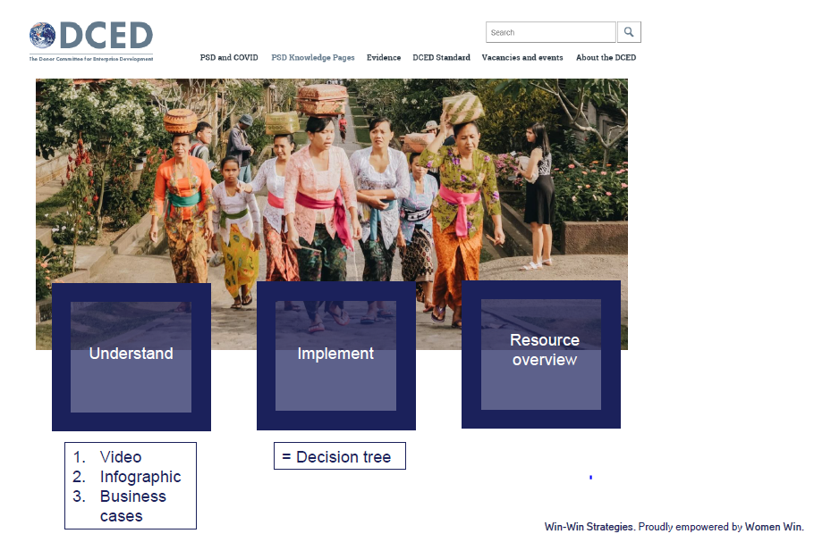
WEE Gateway
Slide 28

Slide 29
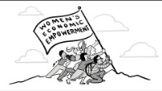
DCED Video
An Introduction to Women's Economic Empowerment - YouTube
Slide 29

Slide 30
GENDER LENS INVESTING (GLI)
Recently published a working paper: Donor Engagement in Gender Lens Investing: Approaches and opportunities – includes an annotated bibliography of useful resources in GLI, with further research to follow.
Key takeaways from research so far:
Gender expertise needs to be increased across the investment process, and donor agencies can contribute through gap-bridging efforts, e.g.:
‘Translating’ between gender and finance professionals
Contributing to standards-setting and challenging traditional frameworks
Funding research to build evidence-based methodologies to grow collective capacity of the field
Slide 30

Slide 31
MSMEs AND THE CARE ECONOMY
A research brief will be published in the coming months: Childcare Solutions for Women Micro and Small Enterprises
Specific focus on childcare:
”
The amount of time women spend on unpaid care work markedly increases with the presence of young children, particularly those under five years old. In Ghana, for example, women spend 107 more minutes on unpaid care work per day when a young child is present, an increase of 70 per cent compared to no children in the household. The corresponding increase for men is just three minutes. This demonstrates the specific importance that childcare services can have in alleviating women’s unequal responsibility for care.
”
Slide 31

Slide 32
THE ROLE OF SOCIAL NORMS FOR WEE
The Working Group is exploring the topic of social norms and their effect on WEE and programming.
Goal of the work item is to create podcasts and short summary papers as well as conducting webinars on promising interventions on addressing social norms to foster women’s economic empowerment in developing regions.
First results expected in Summer / Fall 2022
Slide 32

Slide 33
Agenda
13:30 – 13:40 - Background and Introduction
13:40 – 14:20 Strategic framework for Women Economic Empowerment Interventions from DG INTPA, DG NEAR and AECID
14:20 – 15:00 Donor Committee on Enterprise Development
Intervention from DCED and FemDev Consulting
15:00 – 15:15 Break
16:20 – 16:30 Wrap up and closure
15:15 – 16:20 Exchange experiences MSOs
Intervention from Expertise France, EU Delegation Zimbabwe and ICR Facility (BC)

Slide 34



Women’s Economic Empowerment and COVID-19
Dr. Kate Grantham
March 22, 2022

Slide 35

How should DCED members adjust their programmes to ensure women's economic empowerment during the COVID-19 pandemic?

Slide 36

Economic Risks and Challenges for Women During COVID-19
The care economy
Women’s work and livelihoods
Women-owned enterprises
Housing, land and property rights
Access to education
Sexual and gender-based violence
Sexual and reproductive health and rights

Slide 37
Donor and Development Agency Responses
Adjusting operations and programming
Issuing new support
Contributing to global research efforts

Slide 38
Critical and Under-Addressed Areas of WEE
Women-owned enterprises and entrepreneurship | Digital and financial inclusion | Informal sector workers | Paid and unpaid care work
Underlying factors affecting WEE

Slide 39


Kidogo Childcare Centres in East Africa
Kidogo provides quality childcare for low-income communities and livelihoods for women (“mamapreneurs”) in Kenya Pivoted to support families during COVID-19 by launching a “Digital Caregiver” initiative and distributing over 60,000 “Play Packs”
Women in Business Programme in Mozambique
WIN works with the public and private sector to support market solutions for low-income entrepreneurial women Developed innovative media content to reach women entrepreneurs during COVID-19, including a radionovela called “Janette”

Slide 40
Key Recommendations
Adopt and promote a multidimensional approach to WEE
Increase attention and investment in critical and under-addressed areas of WEE
Monitor and evaluate the gender impacts of COVID-19 responses
Share information and resources for promoting WEE during COVID-19
Work in partnership with local gender experts and women’s organizations

Slide 41
How did you adapt your WEE programming and implementation during COVID-19? For your non-WEE programmes: Did you integrate a gender-lens as a result of the pandemic?

Slide 42
What kinds of WEE-related projects and priorities are you currently working on?

Slide 43
Questions and discussion
Slide 43

Slide 44
Agenda
13:30 – 13:40 - Background and Introduction
13:40 – 14:20 Strategic framework for Women Economic Empowerment Interventions from DG INTPA, DG NEAR and AECID
14:20 – 15:00 Donor Committee on Enterprise Development
Intervention from DCED and FemDev Consulting
15:00 – 15:15 Break
16:20 – 16:30 Wrap up and closure
15:15 – 16:20 Exchange experiences MSOs
Intervention from Expertise France, EU Delegation Zimbabwe and ICR Facility (BC)

Slide 45
Agenda
13:30 – 13:40 - Background and Introduction
13:40 – 14:20 Strategic framework for Women Economic Empowerment Interventions from DG INTPA, DG NEAR and AECID
14:20 – 15:00 Donor Committee on Enterprise Development
Intervention from DCED and FemDev Consulting
15:00 – 15:15 Break
16:20 – 16:30 Wrap up and closure
15:15 – 16:20 Exchange experiences MSOs
Intervention from Expertise France, EU Delegation Zimbabwe and ICR Facility (BC)

Slide 46
Women Economic Empowerment
Février 2022

Slide 47


Expertise France’s approach
Our actions to support women economic empowerment aim at :
Establishing and supporting structures offering services specifically designed to meet the needs of women entrepreneurs
Enabling the emergence of a more inclusive ecosystem

Slide 48

Expertise France’s approach
Through various projects, Expertise France supports women economic empowerment in three areas:
Technical assistance and financing of support structures dedicated to women entrepreneurs
Digital and entrepreneurial capacity building for women
Reform of the business climate in favor of women economic empowerment

Slide 49









Approach 1 - Support and financing of support structures (associations, incubators, accelerators ) dedicated to women entrepreneurs
Project Women and Acceleration for Start-ups and VSEs
FAST Project
Funder
FAST aims at promoting and supporting entrepreneurial initiatives, in order to participate in the fight against youth unemployment and to boost entrepreneurship, particularly among women
A €2M envelope is available to finance incubation structures dedicated to women entrepreneurs in regions
Initiatives are selected through a call for projects
Amount
4,6 M EURO
Implementation
Duration
03/2021 – 03/2024
Location
Tunisie

Slide 50


Approach 1 - Support and financing of support structures (associations, incubators, accelerators ) dedicated to women entrepreneurs
Libyan Private Sector Development Support Program
EU4PSL Project
Funder
The EU4PSL project aims to improve the business environment in Libya in order to generate economic growth and employment opportunities, especially for youth and women
Within the framework of the second axis, Expertise France accompanies and finances 6 civil society organizations that support women entrepreneurs, 12 women have received a grant of € 5000
Amount
10 M EURO
Implementation
Duration
02/2019 – 03/2022
Location
Libye

Slide 51


Approach 2 - Strengthening the digital and entrepreneurial capacities of women
Project RAQAM-E
Funder
The Raqam-e project aims to foster the economic integration of youth and women through the creation of code schools in Libya
One of Raqam-e's project activities supports and empowers women by encouraging them to explore a wider variety of jobs related to new technologies
Amount
1,5 M EURO
Implementation
Duration
03/2021 – 03/2024
Location
Libye

Slide 52

Approach 2 - Strengthening the digital and entrepreneurial capacities of women
The programme Territoires créateurs d’emploi
Funder
This program aims to contribute to regional stability by addressing the root causes of instability, forced population displacement, and irregular migration through improved economic opportunities, equal opportunity
More specifically, the project aims to stimulate the employability of youth and women by developing their entrepreneurial skills through vocational training adapted to local demand
6000 young women trained
50% of women beneficiaries minimum
1000 micro-enterprises supported
Amount
5 M EURO
Implementation
Duration
09/2019 – 09/2021
Location
Burkina Faso

Slide 53
Approach 3 - Business climate reform for women's economic empowerment
Promoting equal opportunities for women in the labor market through business environment reforms
Promoting the inclusion of women and women's associations in public-private dialogue: an imperative for sustainable development
Supporting women-owned businesses through business environment reforms
FACILITY ICR Women's economic empowerment

Slide 54
Agenda
13:30 – 13:40 - Background and Introduction
13:40 – 14:20 Strategic framework for Women Economic Empowerment Interventions from DG INTPA, DG NEAR and AECID
14:20 – 15:00 Donor Committee on Enterprise Development
Intervention from DCED and FemDev Consulting
15:00 – 15:15 Break
16:20 – 16:30 Wrap up and closure
15:15 – 16:20 Exchange experiences MSOs
Intervention from Expertise France, EU Delegation Zimbabwe and ICR Facility (BC)

Slide 55

Practitioner’s Network – Women Economic Empowerment
Investment Climate Reform Facility – 22.03.2022

Slide 56
Our support to ACP partners
Objective | Support the countries and regional institutions in Africa, the Caribbean and the Pacific in their public-private dialogue process to create a more conducive and sustainable investment climate.
Demand-based mechanism for Business Environment Reform
(short term, individually tailored)
Strengthening Development Finance Institutions
(medium term, individually tailored)
Fostering learning & exchange
(reports, webinars, virtual exchange, trainings)
Special Focus on Women’s Economic Empowerment

Slide 57
ICR Facility work on Women´s Economic Empowerment (WEE) so far

Slide 58


Development Finance Institutions (DFIs) & Gender
Tanzania Agricultural Development Bank (TADB) Agribusiness Financing for Women & Youth (2021-2022)
Development Bank of Rwanda (BRD) Gender Policy Review (2021)
Objective: To facilitate the development and deployment of tailored financial products aimed at achieving greater access to financial services for women and youth in agribusiness
Results:
(1) technical study on the landscape of agribusiness financing to women & youth
(2) development of a gender scheme & strategy
(3) PPD workshop on gender scheme & strategy
Objective: To review and support BRD’s gender policy to promote gender mainstreaming to make BRD interventions more efficient, effective, and relevant.
Results:
(1) reviewing of BRD’s gender policy
(2) identification of priority areas for improvement
(3) creation of a gender action plan

Slide 59
Knowledge series – 3 ICReports
Business Environment Reform to support women owned businesses
(Legal, administrative, and policy reforms necessary to promote women’s access to assets and credits, as well as their ability to register and manage their businesses)
Business Environment Reform to promote equal opportunities for women in the labour market
(Legal, administrative, and policy and tax incentives and reforms necessary to promote a more inclusive labour market for women to have better quality jobs)
Promoting women’s organisations into Public Private Dialogues to foster Women’s Economic Empowerment
(Support the creation, growth and sustainability of women’s business associations (WBA) and women’s chapters in chambers of commerce as well as support their inclusion in Public Private Dialogue)

Slide 60
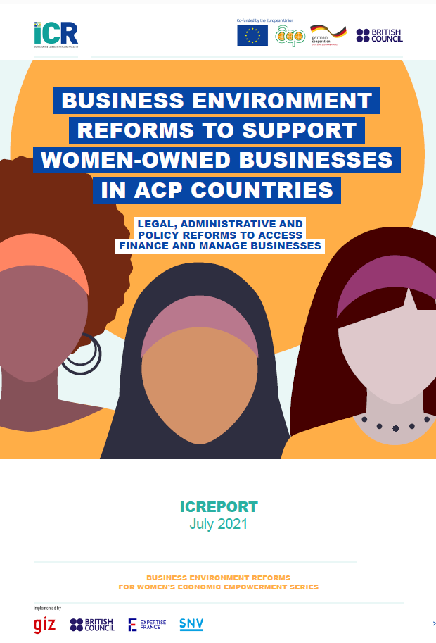
Key findings: BER to support women-owned businesses
Legal frameworks must be updated to ensure that ownership rights, inheritance regimes, and family codes (and more) are equally applied. This will enable women to fully access property, own land and assets, and thus access credits and grow their business.
Reducing complicated and lengthy administrative barriers is critical to supporting women in formalising and operating their businesses.
Promoting access to finance, such as through women’s credit lines or new ways of measuring credit scores, have shown positive results on women-owned/led businesses. They can create an enabling environment to promote women-owned/led businesses’ formalisation, growth, and sustainability while benefiting the economy.

Slide 61
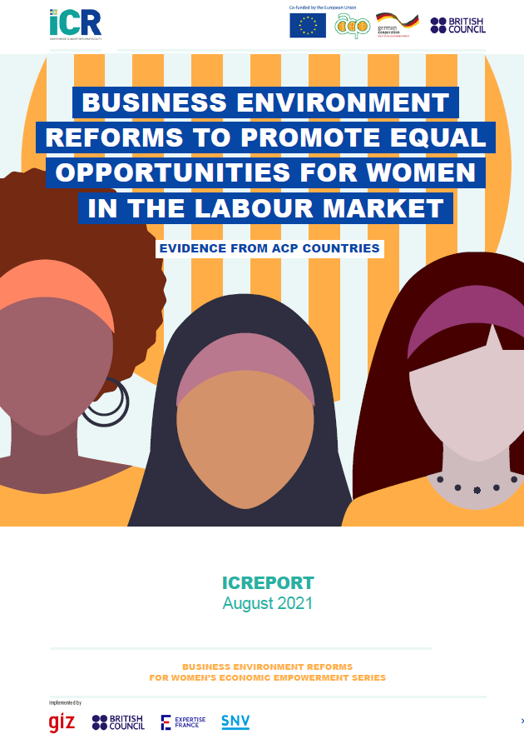
Key findings: BER to promote equal opportunities for women in labour market (Link)
Having equal opportunities under the law is essential to promoting equal opportunities for women in the labour market. The lack of equal treatment under the law, negatively affects women’s access to the labour markets, earnings, and participation in highly productive activities.
In ACP countries, policies and regulations still prohibit or create barriers for women from entering traditionally male-dominated industries, which often provide higher earnings and more job opportunities. BER could enhance women’s access to these specific job markets, thus reducing existing occupational segregation and gender stereotypes.
Fiscal systems and policies can influence women’s employment decisions and can limit or promote women’s labor market participation. Public procurement opportunities for targeting increased participation of women, either with quotas in traditionally male-dominated sectors or for the inclusion of women-owned businesses, can be useful for promoting a more inclusive labour market.

Slide 62
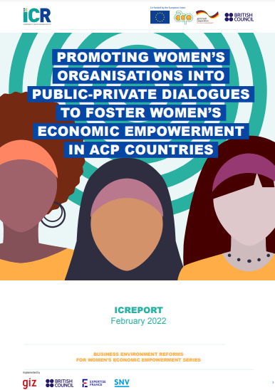
Key findings: Promoting women’s organisations into PPDs to foster WEE
Social and cultural norms, family dynamics, and laws and regulations affect women’s likelihood to participate in PPDs, both as decision-makers and as private sector representatives.
Women’s participation in PPDs is key to supporting reforms that benefit women-owned businesses and female workers.
Promoting women’s associations and women’s chapters of chambers of commerce can help to encourage more inclusive PPDs.
Women’s organisations can champion key business environments reforms in PPDs that promote better work conditions for female workers and women owned businesses.

Slide 63
Focus group meeting on WEE: challenges identified by participants
Limited access to market, financial products, services, education (incl business, soft skills), opportunities
Unfavourable social and cultural norms, ownership rights (land, livestock)
Poor implementation of policies and reforms, Lack of the required infrastructure for innovative approaches for WEE programmes
Limited representation of women in PPD, boards, political offices, no unique voice for women
Limited data and research on women entrepreneurs
Difficulties and frustration associated with business formalisation
Sexual harassment (borders, workplace etc.) GBV, insecurity

Slide 64
Focus group meeting on WEE: potential support identified from participants
Develop training for women (associations) to become powerful advocates for reforms, policies etc, for women entrepreneurs
Technical Assistance for reforms (incl. implementation and evaluation): social, cultural, rights etc., business
Financial products for women, Affirmative funds, funding partnerships, longer term funded projects
Mentoring programmes, Leadership board readiness programme
Fostering knowledge and exchange, research, database on women entrepreneurs, Peer-to-Peer exchange
Support for PPD secretariat

Slide 65
ICR Facility WEE upcoming work

Slide 66





Potential areas of support to WEE through ICR’s through -on demand- mechanism
Addressing data gaps for gender-sensitive investment climate policies
Strengthening capacities of local actors to organize, process, analyse and interpret the data for policy making.
Addressing the legal and regulatory barriers affecting women more significantly
Addressing gender-biased policies and practices
Strengthening the participation of women in investment climate reform processes
Other topics:
Business environment reform (national, sectoral, regional)
Sustainability of the business environment
Support to Public-Private Dialogue structures and mechanisms
Eligibility
Public and private stakeholders
in African, Caribbean and Pacific countries (OACPS)
such as ministries, government agencies, business membership organisations, chambers of commerce

Slide 67



Development Finance Institutions (DFIs) & Gender
Upcoming Call for Proposals
Awareness raising activities
Up to six DFIs to receive technical assistance from 2022-2025
Study on gender best practices in ACP DFIs (April 2022): showcased activities relate to the DFIs’ internal processes (e.g., a gender strategy, etc.) as well as their client-oriented activities (financial products, facilities, TA offers, etc.).
Call for Proposals to launch June 2022
Focus topics: Women’s Economic Empowerment & Gender-lens Investing
Webinar on best practices (April/May 2022)

Slide 68
WEE training - strong training capacities for WEE in ACP countries
BER WEE course that addresses the themes identified from ICR WEE series, TA and DFI work and focus group meeting and other consultative process
Training 20 WEE course facilitators from the ACP.
A self-paced open online BER for WEE course that can be offered with light touch moderation and accessed at any time
In person Delivery of BER for WEE course across the ACP, four times per year to practitioners from across the ACP regions by 20 WEE course facilitators.
- TA requestors (incl. staff), consultants, individuals linked to the implementation of intervention
Gender training course for DFIs:
Pilot training delivered in cooperation with the African Association of DFIs in June 2022
The objective is to build competency in gender-based investments, help operationalise gender desks, share existing best practices, provide an overview of funding opportunities and connect gender equity investing to SDGs, ESG considerations, monitoring and reporting
The training will be integrated to the BER WEE training

Slide 69



Technical Assistance
Interventions of max. 90 expert days
Technical Studies: data and analysis to inform decision-making and policy-making in ACP states
Trainings: capacity building on methodology/tools to meet interests of partners and beneficiaries
Tailored Advisory: implementation and evaluation of business environment reform programs, as well as helping to develop own tools to make informed decisions

Slide 70

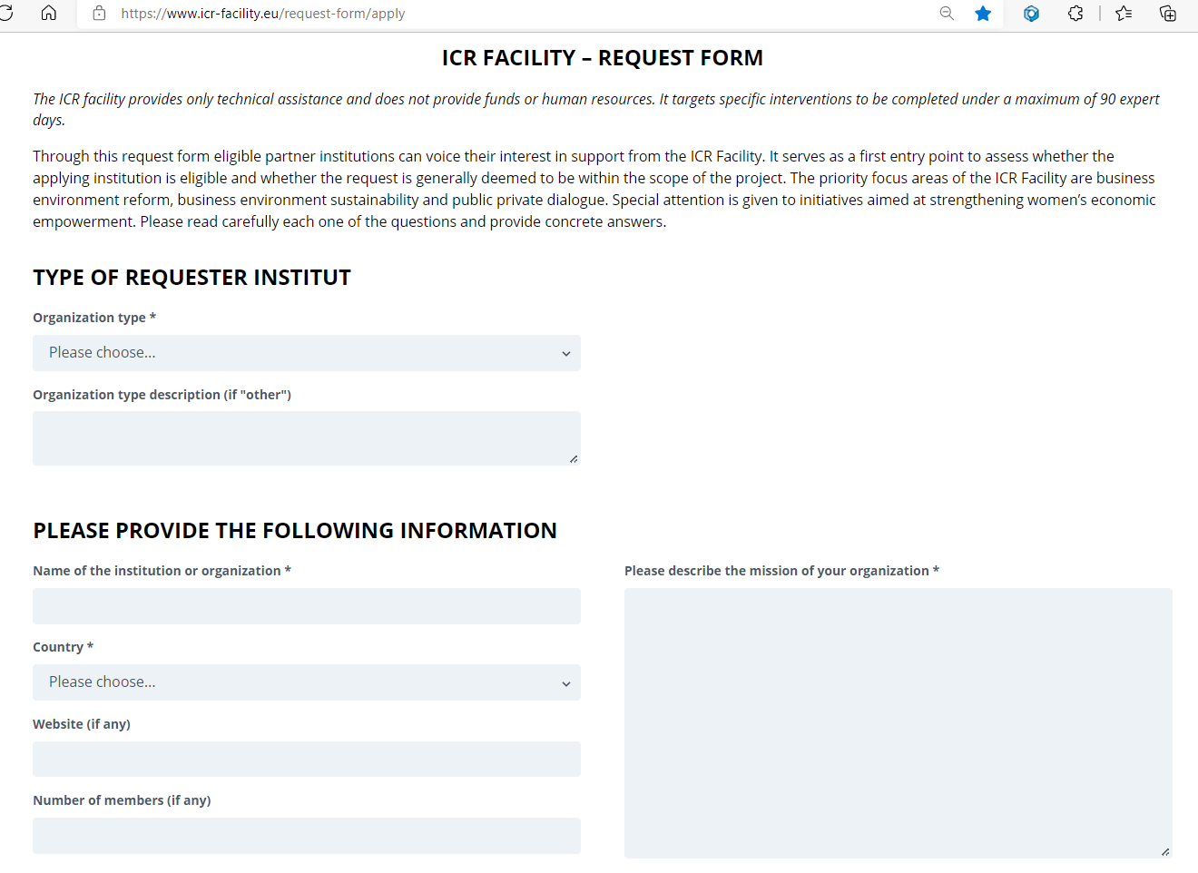
Technical Assistance How to hand in a request
Do you know or collaborate with organisations who are potential beneficiaries?
They can send us a request!
www.icr-facility.eu/request-form

Slide 71



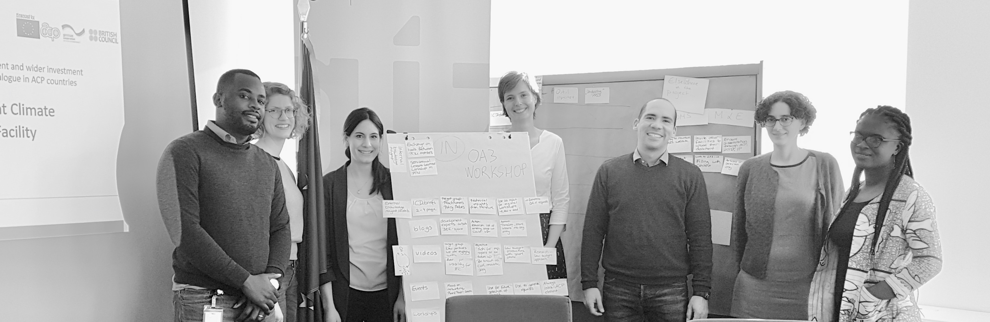

Thank you
info@icr-facility.eu
www.icr-facility.eu
Investment Climate Reform Facility
ICR Facility

